Slide 1

Welcome to
Intro To Coding
@
THINGS YOU NEED TO DO BEFORE CLASS BEGINS:
Put your full name in the chat for check-in
Create a Replit.Com account for our mini project!***
Please complete our Welcome Survey at grandcircus.co/welcome
***SUPER important.
Don’t be afraid to ask us if you need help!
RESOURCES FOR THE CLASS:
Slides:
grandcircus.co/itc-remote
Student Activity Guide:
grandcircus.co/itc-guide
http://grandcircus.co/welcome

Slide 2
Front-End vs Back-End Languages
Front-End: HTML, CSS, JavaScript
What the users can see and interact with
Define what goes on in your web browser (the “client side”)
This will be the focus of today’s class
Back-End: C#, Java, Python, among others
What stores and uses data
Define what happens on a web server to process information and return web pages (the “server side”)
Notes:
In this session we’re focusing on HTML, CSS, and JavaScript because you’ll need these in any web development bootcamp, Front-End or Back-End.

Slide 3
General Roles of Programming Languages
HTML
Hypertext Markup Language
Describes the structure of a webpage
Consists of tags “marking up” the page content
CSS
Cascading Style Sheets
Changes how the HTML is displayed in the browser -- colors, borders, alignment, etc.
JavaScript
Makes website content interactive
Makes the website do things and respond to user actions

Slide 4
Let’s Get Ready to Code!
Click on the link provided by your instructor
Log into Replit, if you haven’t yet
Click the name of the project at the top of the screen (“Grand Circus Coffee”)
Click on the vertical ellipsis button and select “Fork”
The code will re-load and display your username next to the project title.

Slide 5
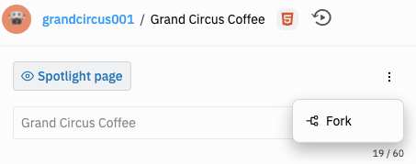
Click on this button to show the “fork” option
There’s a lot of behind-the-scenes code here -- that doesn’t make what we’re doing “not real”

Slide 6
HTML
(Hypertext Markup Language)
Notes:
Hypertext: Provides links to other pages through hyperlinks, which are used to connect one page or part of a page to another.
Markup: Takes a text document and changes it with tags, which are keywords that affect the text in different ways.
Language: A set of rules and vocabulary which can be interpreted by a computer.

Slide 7
Structure and Syntax
An HTML document is made up of several units called elements, which are made up of tags and sometimes attributes.
Element
<h1>Content goes here!</h1>
Opening tag
Closing tag
Attribute
<h1 class=”primary”>Content goes here!</h1>
While tags are essential, attributes are not needed for most tags.
Notes:
Tags: Part of the code which defines the structure of or changes the appearance of the content in the browser.
Opening and closing tags: like a sentence has a beginning and an end
Attributes: Part of the code which modifies or adds meaning to an HTML element. These are added within the opening tag.

Slide 8
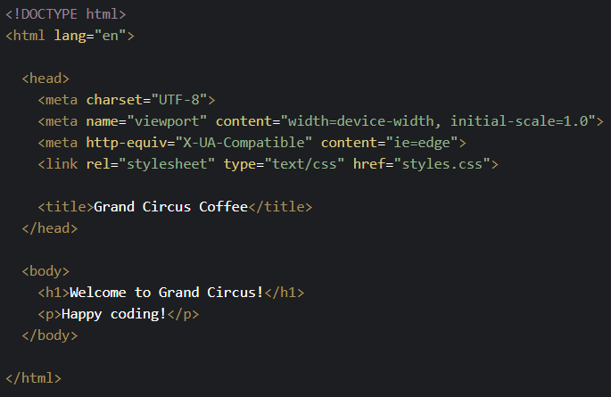
Page Essentials/Structure
The following elements are required for your page to run.
<!DOCTYPE html>: Document type declaration for HTML
<html> & </html>: Everything between the opening and closing tag is a HTML document
<head> & </head>: Header of the page
<body> & </body>: Visuals of the page

Slide 9
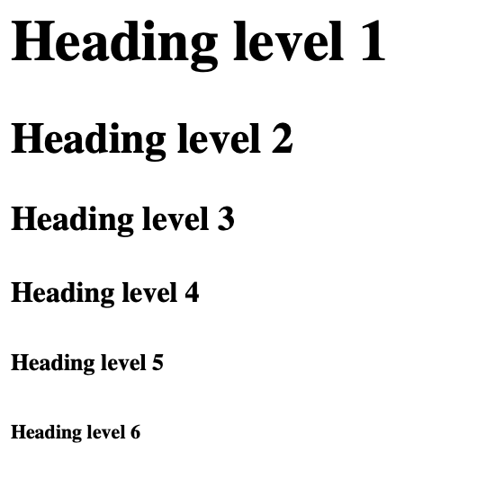
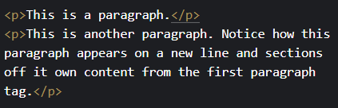
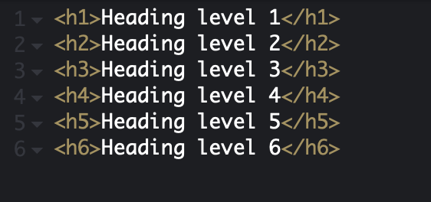
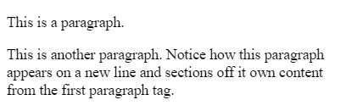
Basic tags
Header tags: <h1> through <h6>
Add a header to the page
Levels 1 through 6, size gets smaller as the number increases
Paragraph tags: <p>
Allow you to section off content, similar to a paragraph in a book
Each paragraph tag will start on a new line

Slide 10
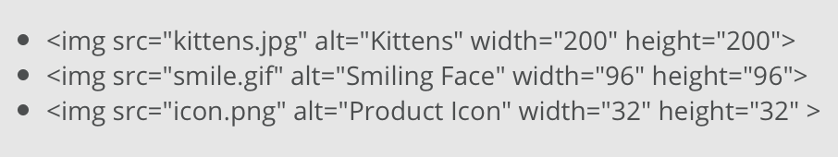

Basic tags
Image tags: <img>
Puts an image on the page
Requires a src attribute for the file pathways
Can use an alt attribute for alternate text
Can also include height and weight attributes. These are defined in pixels (px), a common measurement
Self-closing - no closing tag
Links/anchor tags: <a>
Puts the “hyper” in hypertext markup language.
Creates a link to another page or site (or even link an email or a phone number)
Requires href attribute for URL reference
Content in between opening and closing becomes clickable

Slide 11


Basic Tags
Div tags: <div>
Think of it like a “division”
Divides your content into different sections, typically for layout purposes
Span tags: <span>
Holds a small piece of content, usually for styling uniquely
Use case: highlighting one word within a paragraph or div
<div class="container">
<p>This is a paragraph</p>
<p>This is another paragraph</p>
</div>

Slide 12
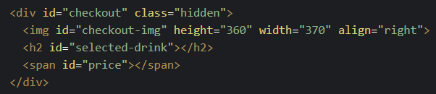
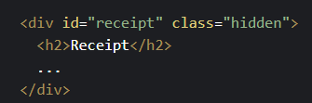
Basic Attributes
We covered some basic common attributes: alt, src, href
However, a couple more common ones you will come across are:
Class: groups different HTML elements together under a common name
For the purpose of this workshop, the use of classes is to assign specific visual styles to multiple elements
Id: help to give a unique identifier to HTML elements
These are often used for assigning specific styles (in CSS) or functionality (in JavaScript) to a group of elements or to one particular element.
Notes:
Alt: Alternate text that describes an image when it fails to load
Src: Specifies the address of an image
Href: Specifies a link target
Title: Gives a title to an element

Slide 13
CSS
(Cascading Style Sheets)

Slide 14
What does it do?
CSS controls the display of a webpage. This includes…
Text and Background Colors
Font and Font Size
Other Cosmetic Aspects
Fitting Different Screen Dimensions
CSS is the design aspect of HTML’s content. Therefore, you cannot have CSS without HTML, as there would be no content to format.

Slide 15
CSS Rule
selector
h1
{
value
color: orange;
font-size: 20px;
}
property
declaration
Notes:
CSS is made up of units called rules. Each rule consists of two parts: a selector and a declaration.
The selector chooses the HTML tag to style
The declaration is further broken down into a property and a value.
The property is what aspect of your selector you want to style.
The value is what you want that property to be
Highlight: The purpose of semicolons, line breaks, and why the curly braces are important and what will happen if they aren’t there!

Slide 16
More About Selectors
A selector with no punctuation selects an HTML tag:
h1 { … }
A selector beginning with a period selects a class (remember that class attribute?):
.hidden { … }
A selector beginning with a # selects an id:
#checkout { … }

Slide 17
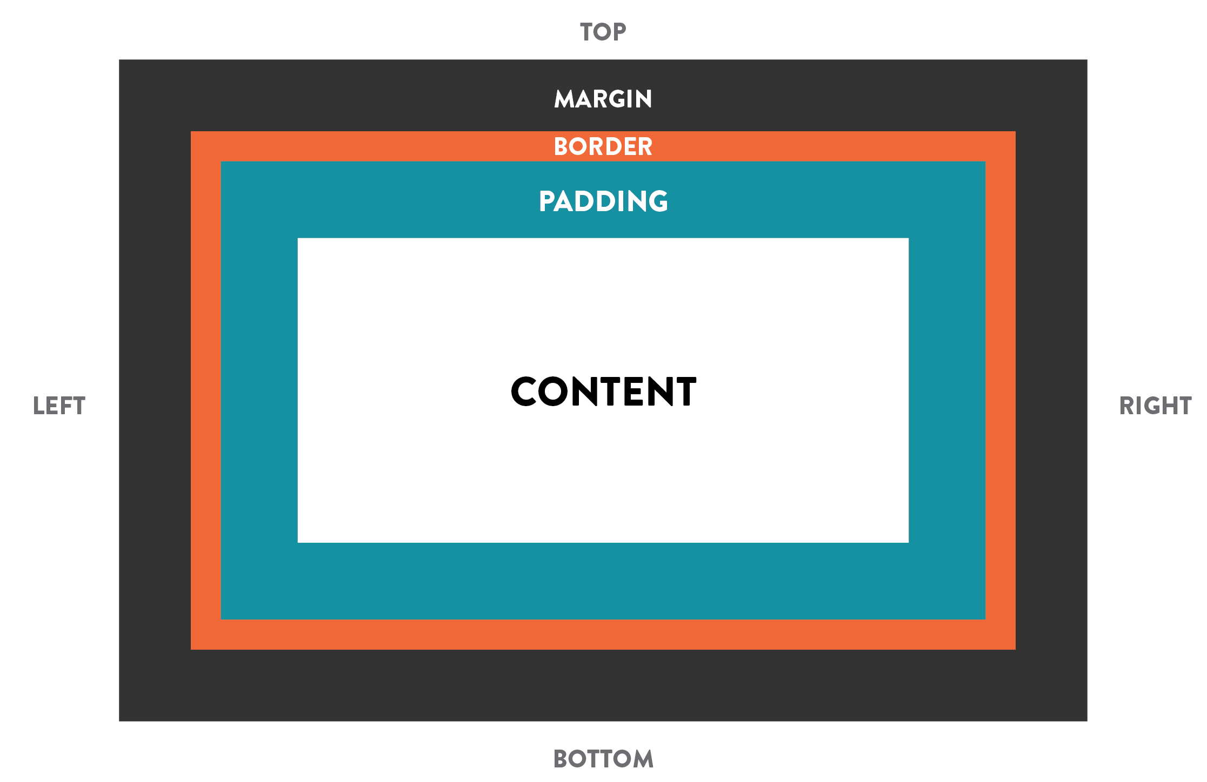
CSS Box Model
Many of the properties relate to the CSS Box Model:
Content: What’s inside the element
Border: the line (could be invisible) around the element
Margin: The space outside the border, between this element and a neighbor
Padding: The space inside the border, surrounding the content
Notes:
Talk about the specific properties listed

Slide 18
JavaScript

Slide 19
What does it do?
JavaScript allows users to program more complex elements into a website:
interactive graphics
real-time updating information
animated graphics
JavaScript puts the traditional code you may think of for apps and games into a website, making it more complex than the static code of HTML and CSS.
HTML and CSS are code. JavaScript is programming.

Slide 20
Variables
Variable: A named “container” to store data values
For example:
x might hold a number
temperature might hold “hot”, “cold”, “lukewarm”
size might hold “small”, “medium”, “large”
A variable’s primary purpose is to label and store data in memory for the web page to use and change, reuse at certain times, and make decisions
Notes:
Callback to algebra - “x” can hold any number JS variables can hold more than numbers though.

Slide 21
Creating Variables
The first time (and only the first time) we use a variable in a script, we create it with the let keyword.
“let” sets up the variable and it prevents us from making some common mistakes with the variable
This is called declaring a variable. You give it a name.
let price; let drink;
We can then put a value into the variable! This is called initializing a variable.
Until we do this, the variable has no value.
price = 4.29; drink = “Latte”;

Slide 22
Creating Variables
Although declaring and initializing are two different steps of creating a variable, you can actually do them both within the same line, like so:
let price = 4.29; let drink = “Latte”;

Slide 23
Functions
Functions help the computer run tasks.
They block code together to run it at a certain time (for example, when a user clicks - this is how we will use them today)
This helps create reusable code that we’d otherwise have to write multiple times
They make our code simpler and make it easier to follow and read

Slide 24
Function Headers and Parameters
When writing a new function, we use the keyword function.
The function header names the function so we can use it later, like in our HTML
JavaScript:
function restart() {
//code goes here
}
HTML:
<button onclick="restart()" id="restart">Start Over</button>
A function can also receive information in the form of parameters.
This information can help drive the task the function is performing.
JavaScript:
function checkout(choice) {
let drink = choice;
}

Slide 25
Conditionals
A conditional is a piece of code which executes if a certain expression is true.
If it’s raining, I should bring an umbrella.
If it’s sunny, I should bring sunglasses.
If is the keyword that tells the program
to recognize a conditional
However, if a condition isn’t met, you can
have add other conditions as well by using
else if.
If no conditions are true, you can have a
“catch all” block of code using else
let item;
if (weather === “sunny”){
item = “sunglasses”;
} else if (weather === “rainy”){
item = “umbrella”;
} else {
item = “jacket”;
}
Notes:
Conditions can be created using comparison operators.

Slide 26
Let us know how we did!
grandcircus.co/itc-followup

Slide 27
Online Resources for Continued Learning!
Codeacademy.com This site has tutorials in many languages. Start with HTML & CSS!
FreeCodeCamp.org
Try C#: https://www.codeschool.com/courses/try-c-sharp
Beginning Java: https://www.udemy.com/java-tutorial/
Notes:
Keep it fresh and explore languages before your next workshop or bootcamp

Slide 28
Start Building Your Network Now!
Add us on LinkedIn
https://www.linkedin.com/school/grandcircus/
It’s a great way to connect with folks in the tech industry and strengthen your understanding of roles and companies, plus it gets your name out there!
Or! Just drop us a line at workshops@grandcircus.co .

